Slide 1
The Natural Water Cycle

Slide 2
Learning Objectives
Students will…
Critically reflect on the significance of the natural water cycle to our planet.
understand how water moves through the water cycle.
identify the processes of the natural water cycle

Slide 3
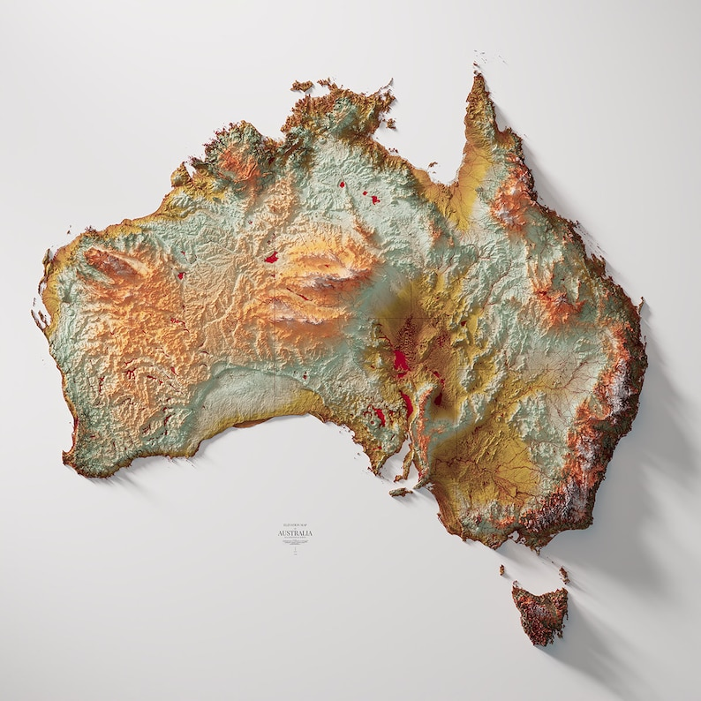
Where is the Water?

Slide 4
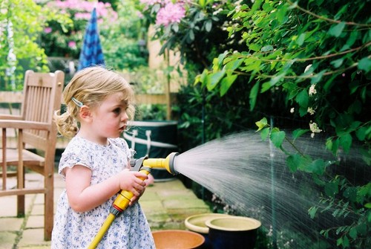
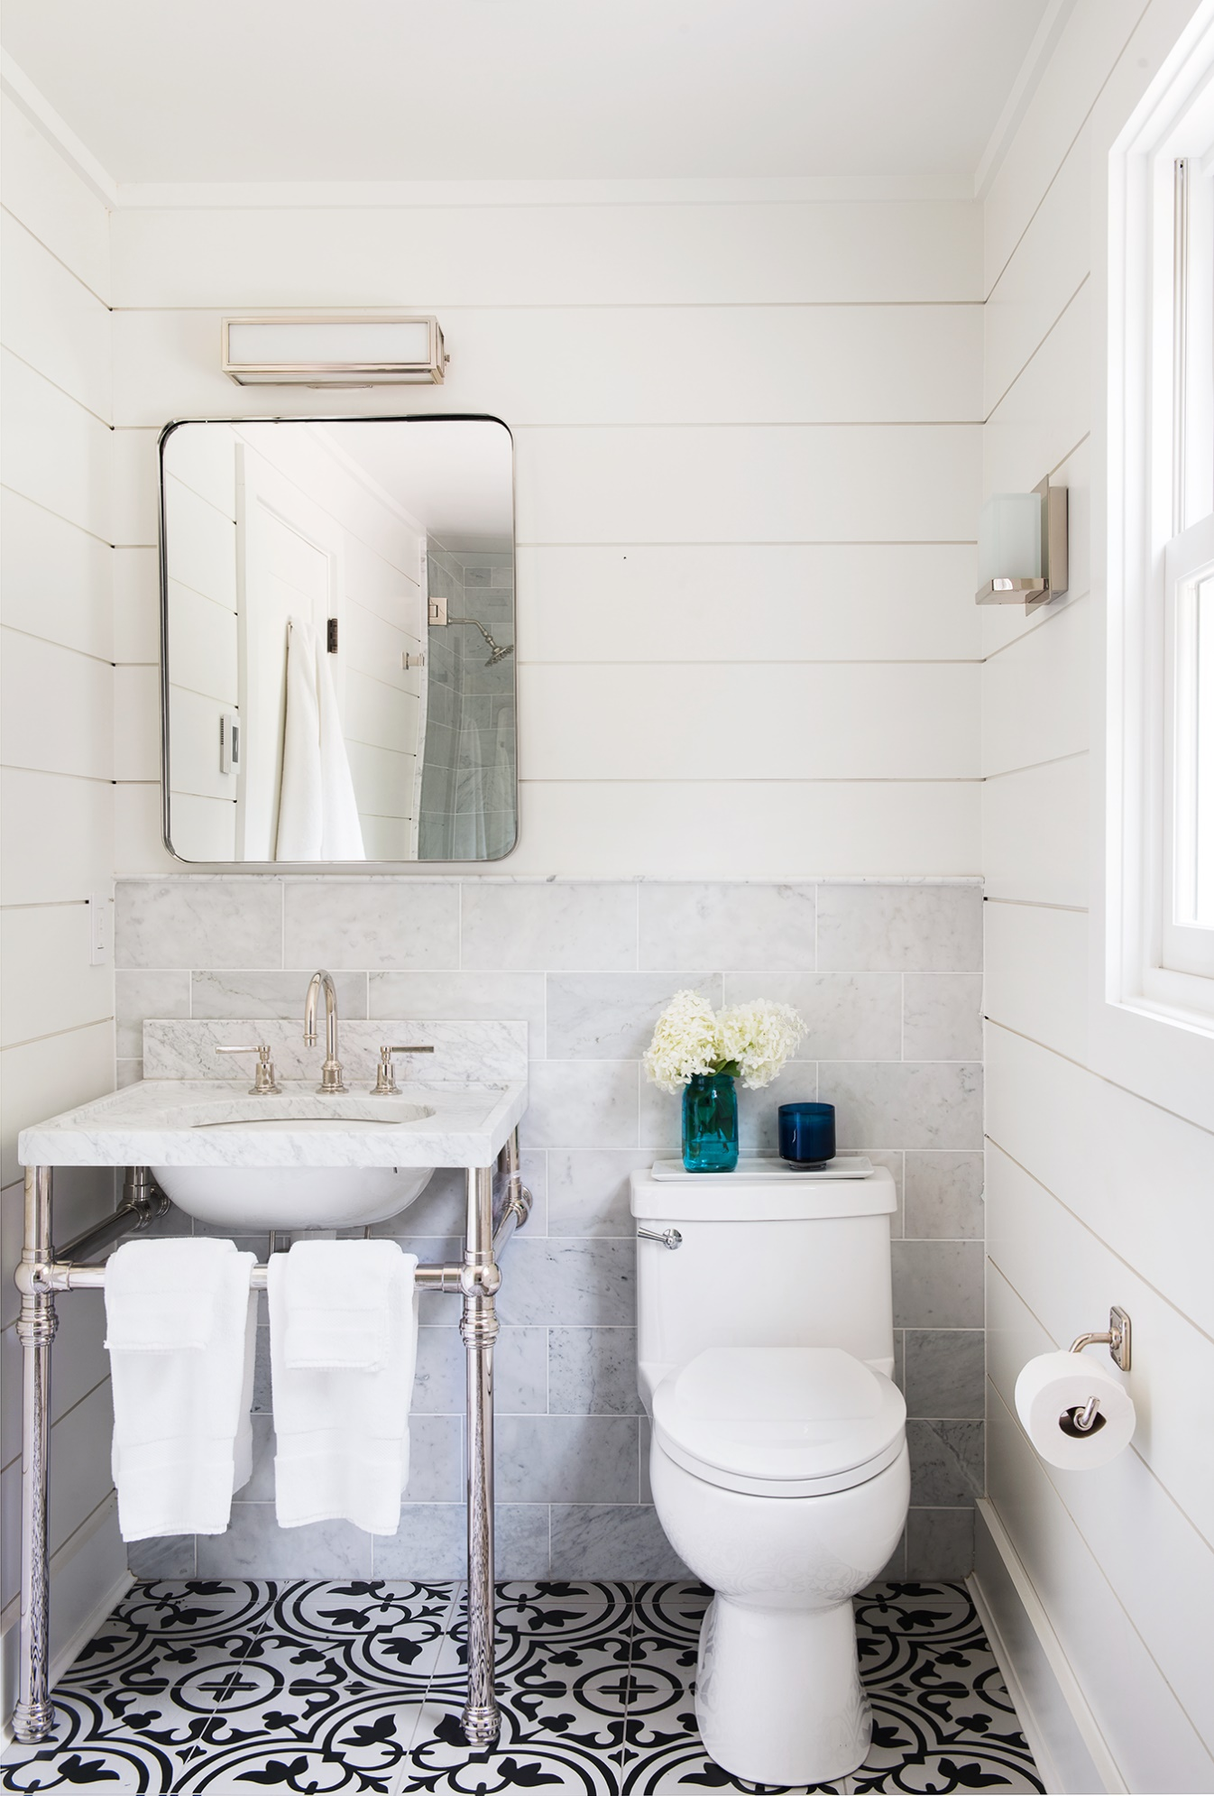
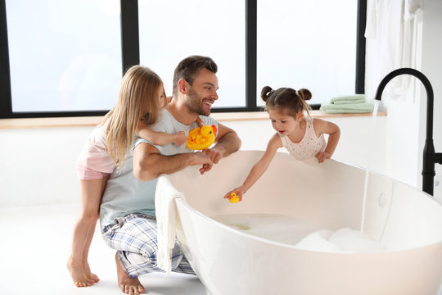
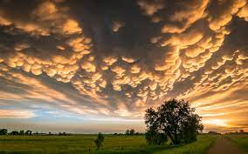
Where is the Water?

Slide 5
BIG
Questions

Slide 6
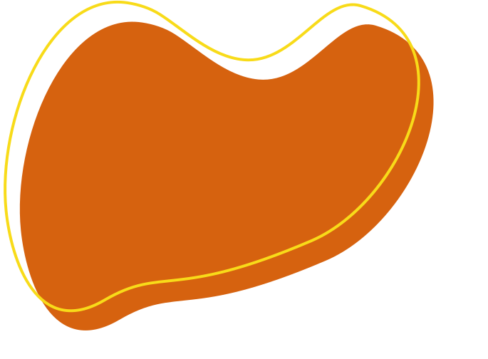
Big Questions
Does water disappear?
Is there ever new water?

Slide 7
The Rhythm of the Rain
By Grahame Baker-Smith
While we read the story, THINK about our BIG questions…! You might have an answer at the end.
Does water disappear?
Is there ever new water?

Slide 8
The Rhythm of the Rain
By Grahame Baker-Smith

Slide 9
Can we answer our BIG Questions?
Does water disappear?
NO!
Is there ever new water?
NO!

Slide 10
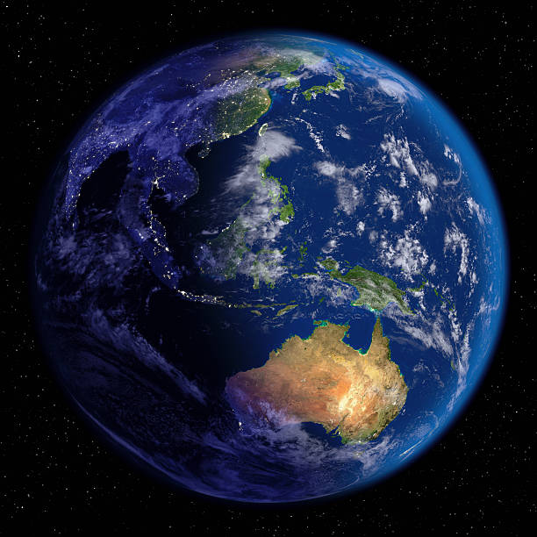
All the water we have is on Earth.
There is no more.

Slide 11
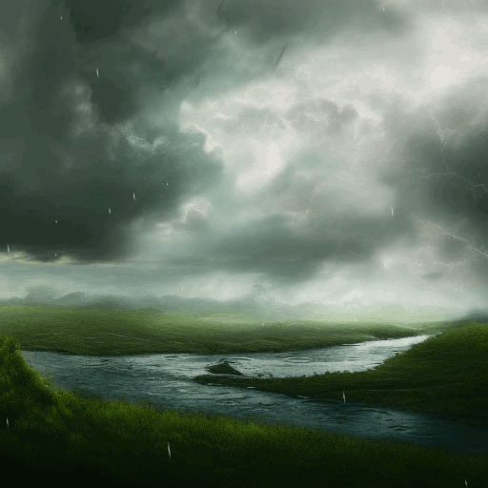
Water is constantly on the move.
It can be in lots of places.
We call this movement The Natural Water Cycle.

Slide 12
What are the parts of the Natural Water Cycle?
TASK: Complete Part A and Part B as we discuss.

Slide 13
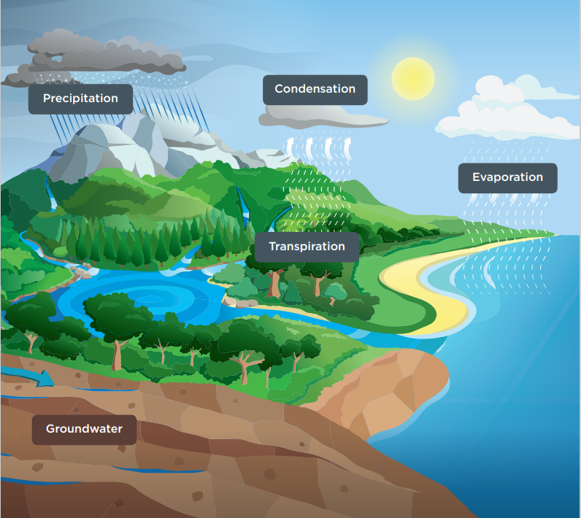
Evaporation
The sun heats water bodies across Earth, causing the liquid water to transform into water vapour.
The vapour (or gas) is light enough to rise into the atmosphere

Slide 14
Transpiration
Water is absorbed by a plant’s roots as a liquid, then travels up to its leaves before it is released as water vapour through the plant’s stomata into
the atmosphere.

Slide 15
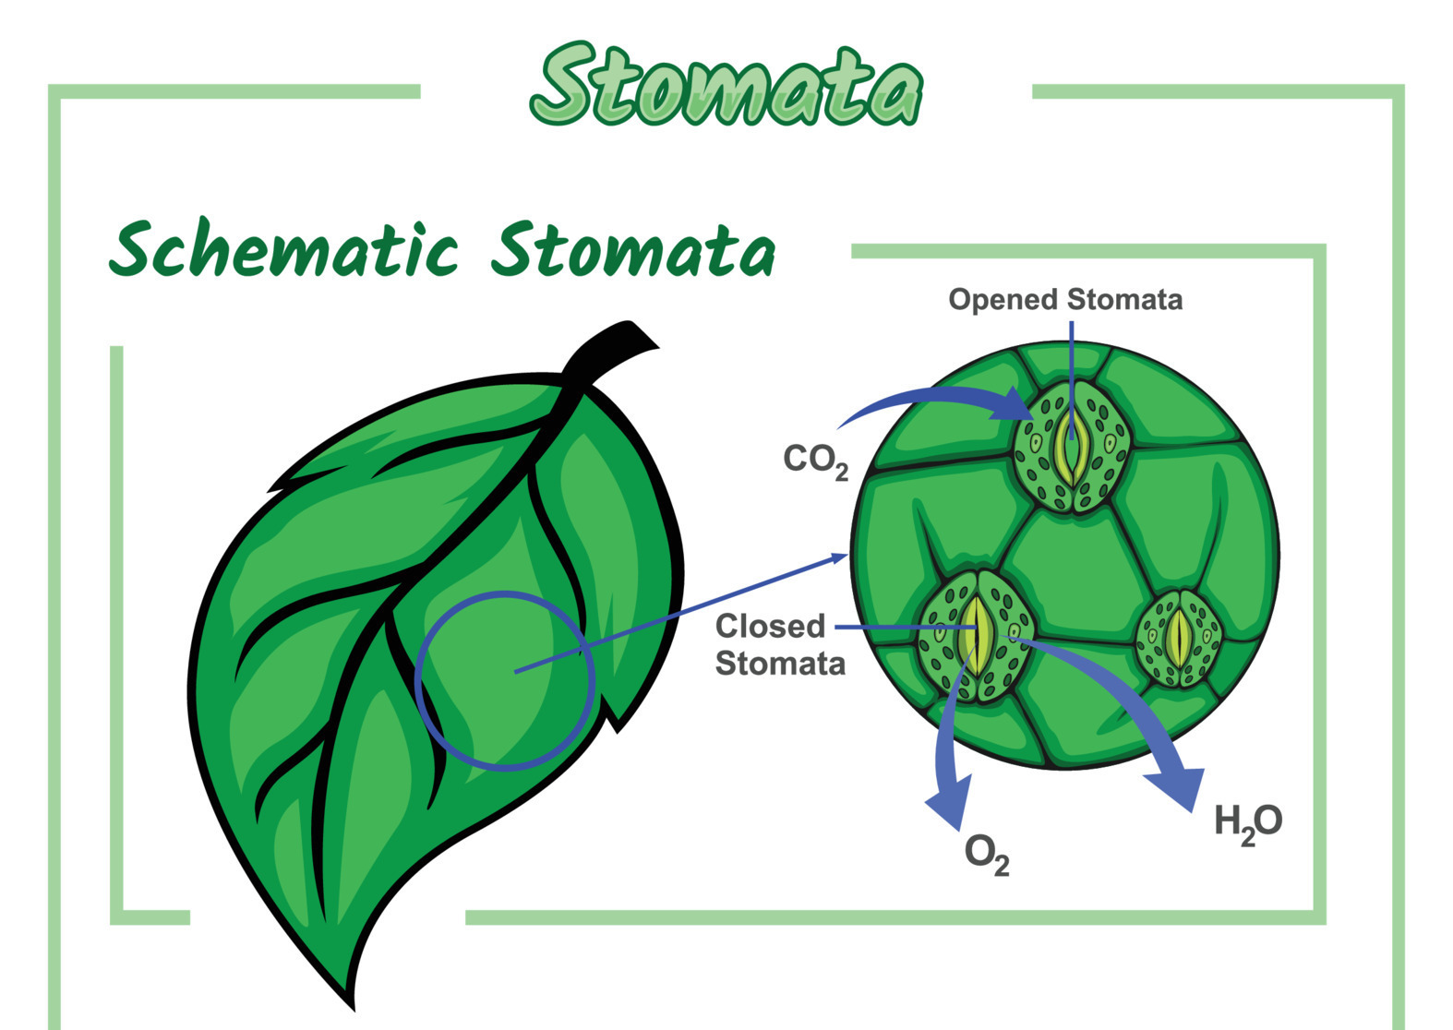

Slide 16
Condensation
Water vapour rises into the air where the temperature becomes colder, and condenses
the water vapour into small droplets which form clouds.

Slide 17
Precipitation
When so much water has condensed in the clouds that the air cannot support its weight, water falls from the clouds as rain, hail, sleet or snow.
Much of this water flows across the land and collects in rivers, lakes and, eventually, the ocean.

Slide 18
Ground Water
Some of the water infiltrates into the ground and gathers in the cracks and pores of rocks, forming groundwater.
These areas of water-filled crevices are called aquifers.

Slide 19
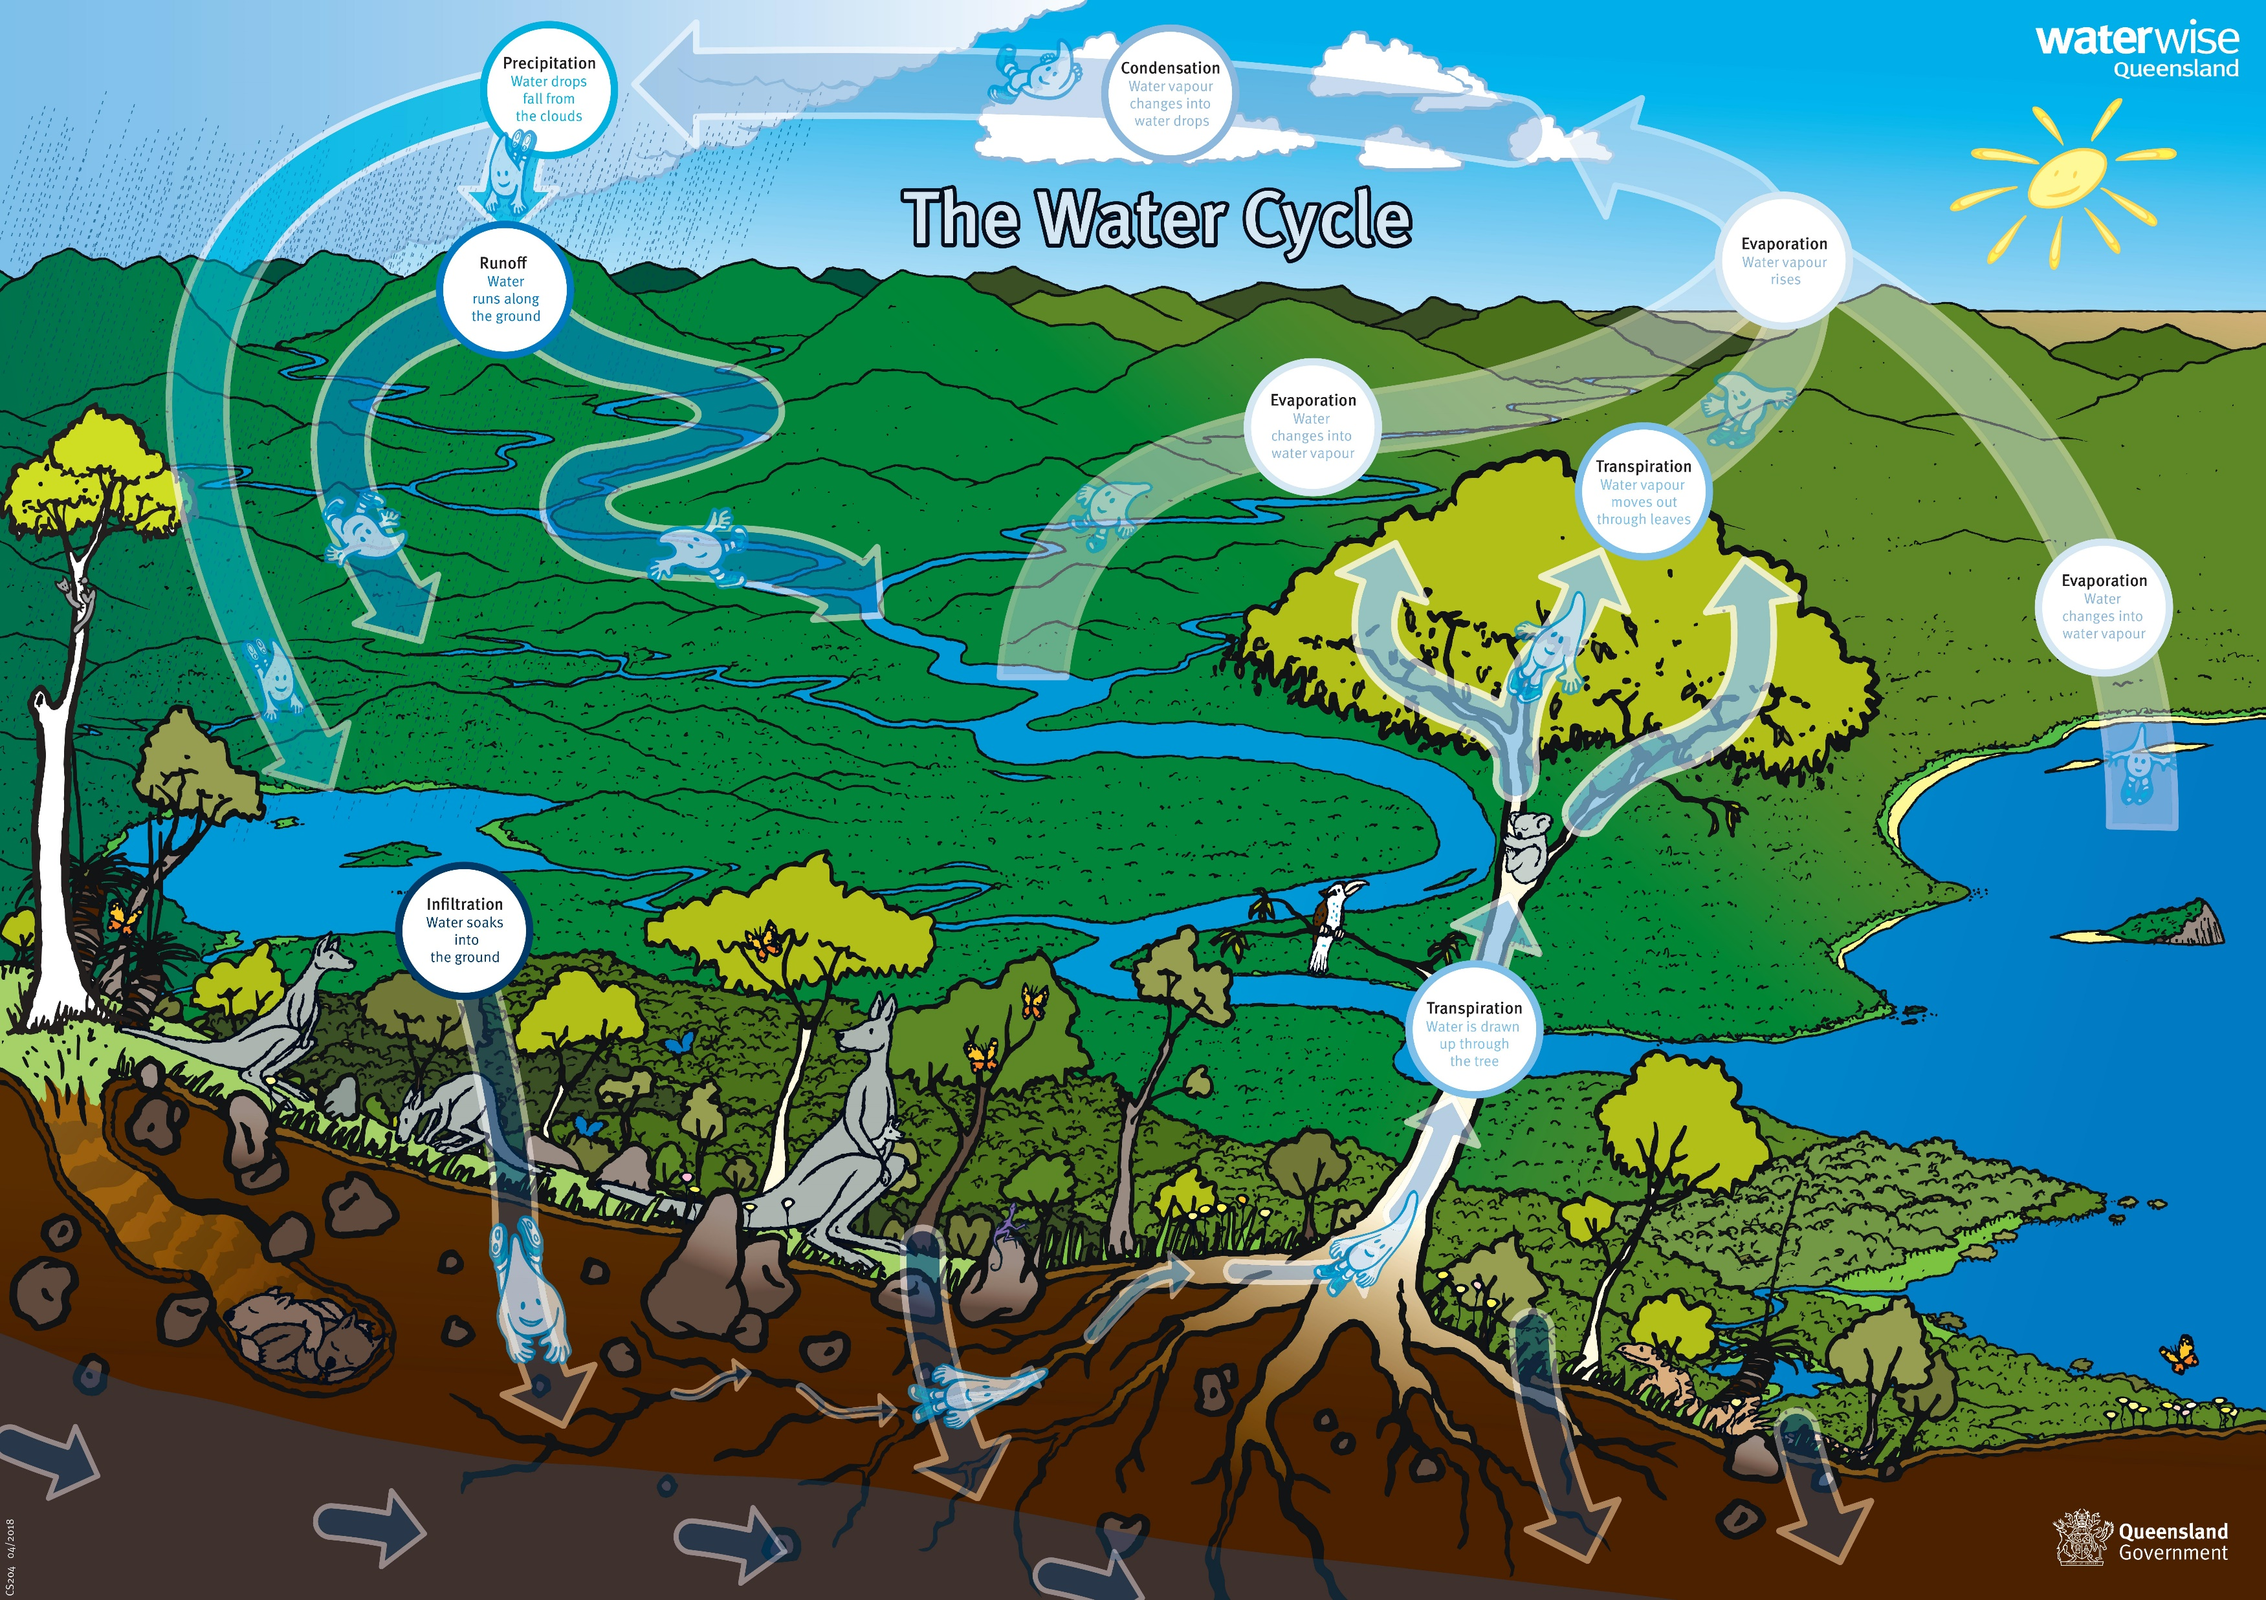
The Natural Water Cycle

Slide 20
Let’s Reflect
At the start of the lesson we brainstormed for ‘water locations’ – Let’s look at them again.
Q: What parts of the water cycle are present in the water locations we thought about at the start of the lesson?
Q: Some of these locations are in our home – does that mean we play a part in the Natural Water Cycle?

Slide 21
Water Cycle Pictionary!
I need FIVE volunteers!
Each answer will be a KEY WORD from today’s lesson.
Can our class volunteers guess them all within the time?

Slide 22
END
1
2
3
4
5
6
7
8
9
10
11
12
13
14
15
16
17
18
19
20
21
22
23
24
25
26
27
28
29
30
31
32
33
34
35
36
37
38
39
40
41
42
43
44
45
46
47
48
49
50
51
52
53
54
55
56
57
58
59
60

Slide 23
Question Time

Slide 24
Extension
Water Cycle in a Jar
Recreate the water cycle by making your own terrarium in this simple experiment.
Refer to ‘Water Cycle in a Jar’ – Page 26-27 extracted from ‘Water. Learn it. Live it’ (Resource C)

