Slide 1
Our Precious Water

Slide 2
With a focus on sustainability, students will learn about the role we all play in protecting the environment and conserving water.
This lesson gives an overview of the urban water cycle and will challenge students to reflect on the responsibility we have for future generations.

Slide 3
Learning Objectives
Students will…
Understand that fresh, accessible water is rare and precious.
Know the key features of the urban water cycle.
Understand that sustainable water usage is essential

Slide 4
How much water is there?

Slide 5
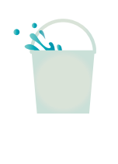
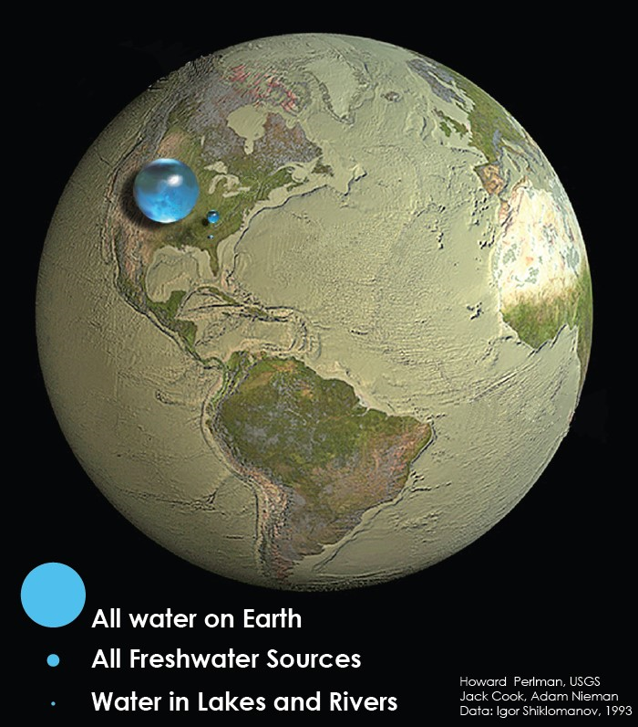
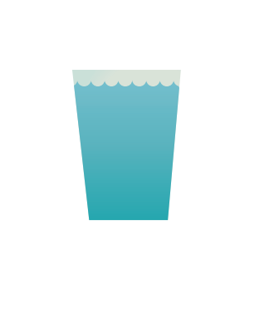
Our bucket is all the water on earth, which is mainly saltwater.
Our glass is all the fresh water on earth, which is mainly ‘locked up’ in glaciers and underground.
Our drop is the surface water we can access from lakes and rivers.

Slide 6
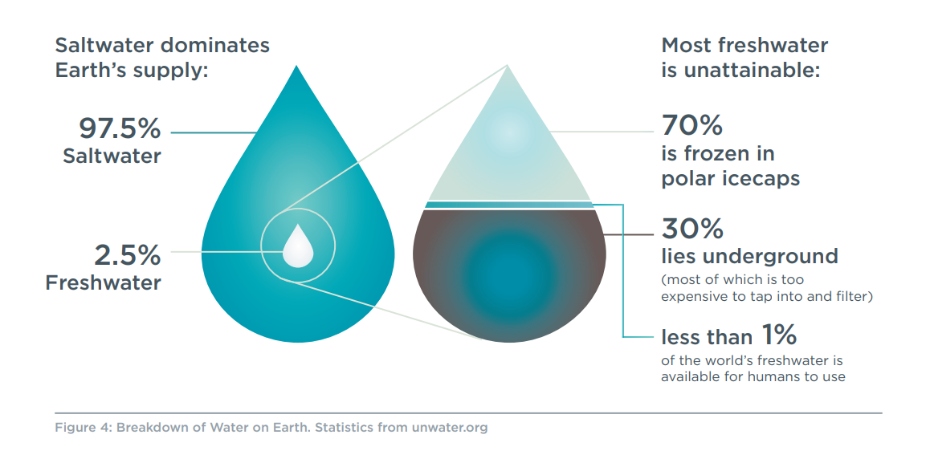

Slide 7
Think, Pair, Share
How would you finish this sentence?
We know that water is rare – but why else is it precious?
“Water is precious because….”
Precious means: has great value; not to be wasted or treated carelessly

Slide 8
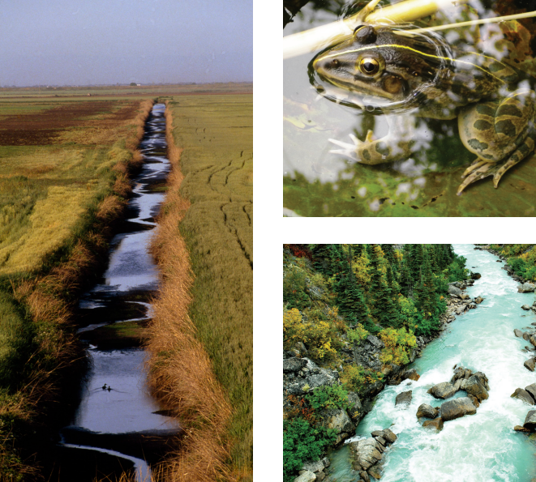
Water is precious because…
our bodies need it to survive!
all animals and plants depend on fresh water.
our industry (places that have jobs) use it.
we can’t grow food without it.
it keeps us clean and healthy.
We can’t live without water – it’s as simple as that.

Slide 9
Let’s reflect:
Traditional Owner perspective on water
“Gatjin(water) is the lifeblood of our country. As gatjin moves through Djandak (Djaara Country): seeping into our soils, entering our groundwater, flowing down our waterways, and pooling in our wetlands, it shapes and nourishes our landscape. It is integral to the health of our People and our Country”
From Dhelkunyangu Gatjin Working together to heal water

Slide 10
What is the urban water cycle?

Slide 11
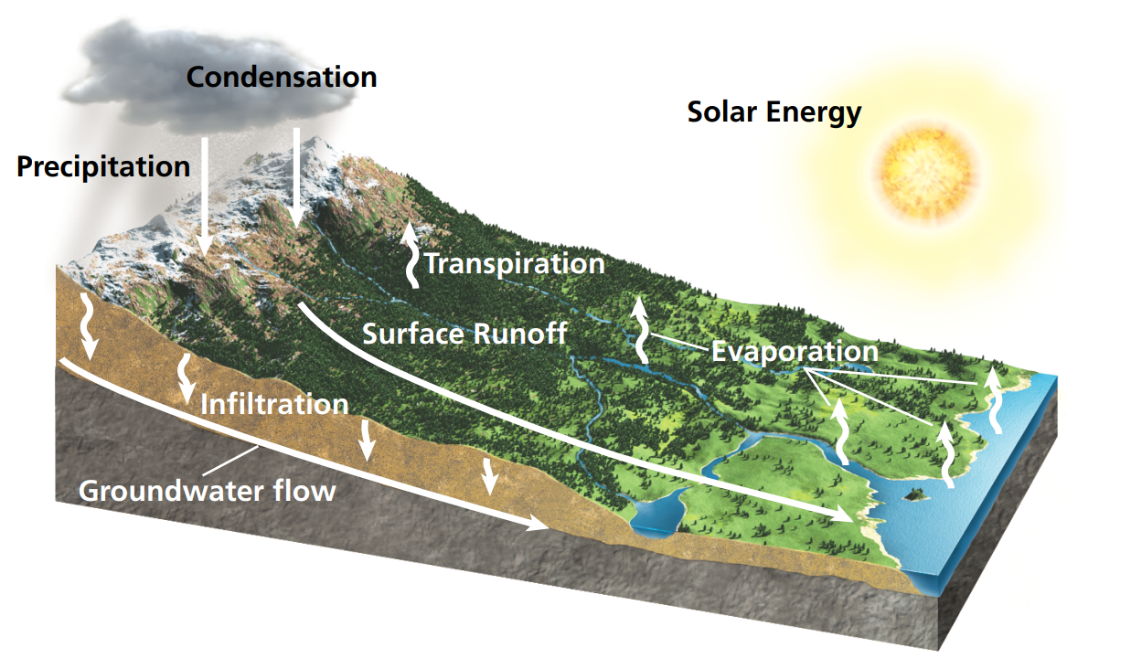
The Natural Water Cycle:
Water is constantly on the move on our planet.
This is the natural state without human intervention.
When human populations were small, fresh water was easily accessible, and rarely polluted.

Slide 12
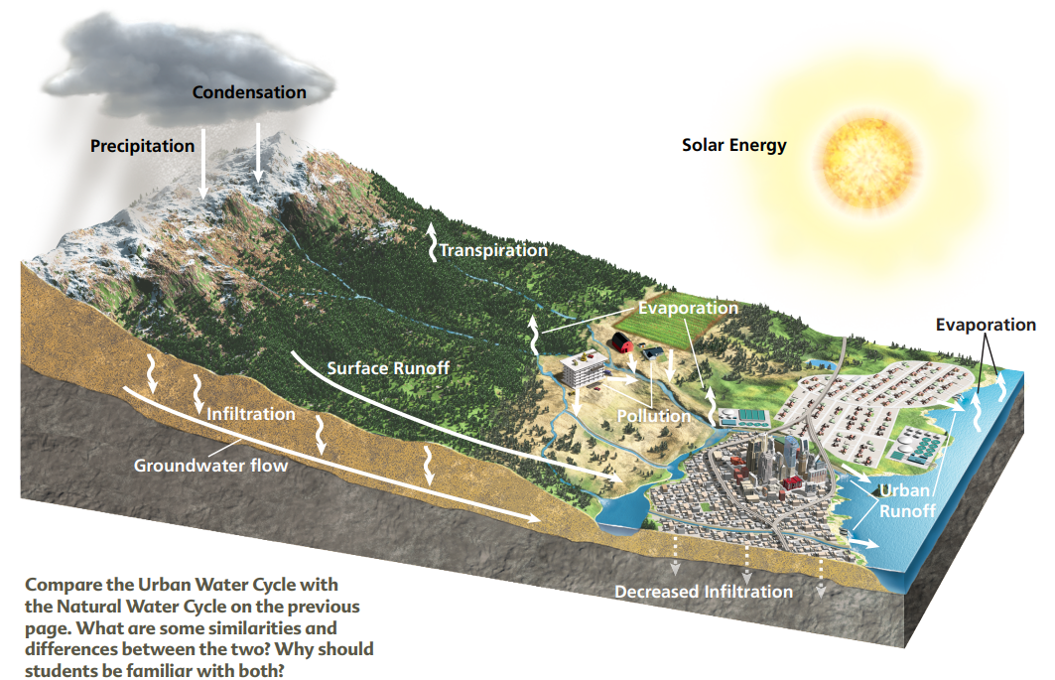
The Urban Water Cycle:
When we began to build cities we interrupted the water cycle.
How have we changed the Natural Water Cycle?
We capture water in reservoirs
We direct storm water
We create waste water and pollution
We also remove trees and plants for agriculture and industry

Slide 13
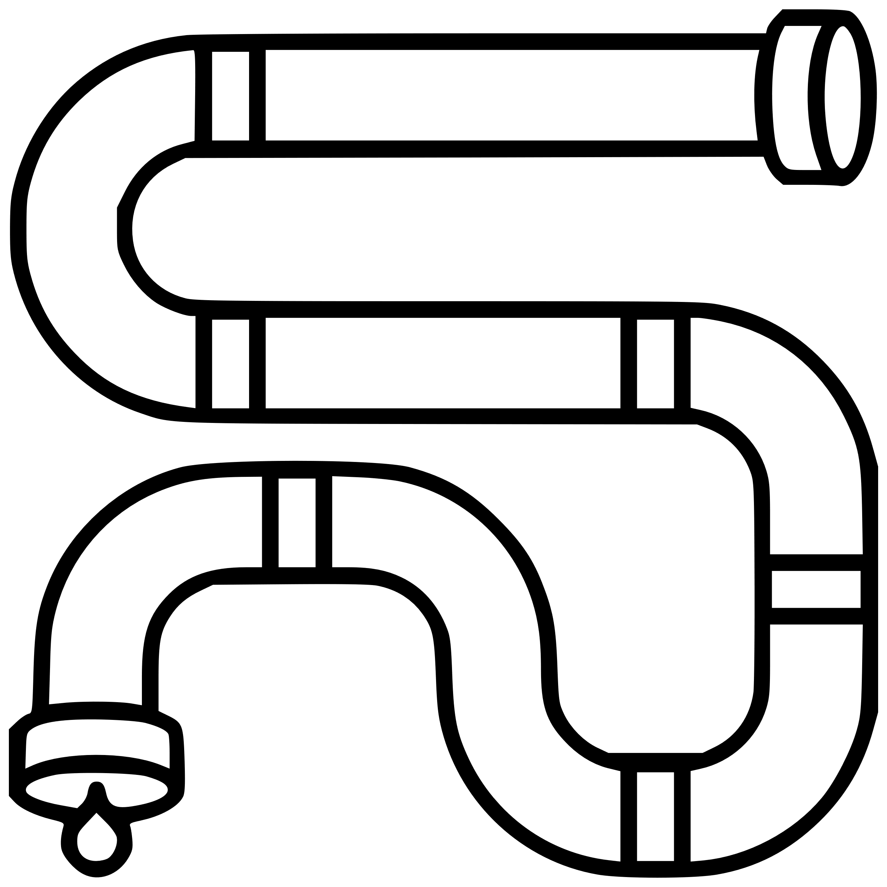
Water supply system
uses dams to store water
treats water at water filtration plants
stores water in reservoirs
can include using desalination to provide a more secure water supply
provides water to our homes, schools and businesses through pipes and pumps.
Wastewater system
removes wastewater from homes, businesses and industry through the wastewater system
treats wastewater at wastewater treatment plants or water recycling plants
returns treated wastewater to waterways or recycles it for further use.
Stormwater system
returns stormwater to local waterways
removes some debris and rubbish
re-uses stormwater for industry and irrigation.

Slide 14
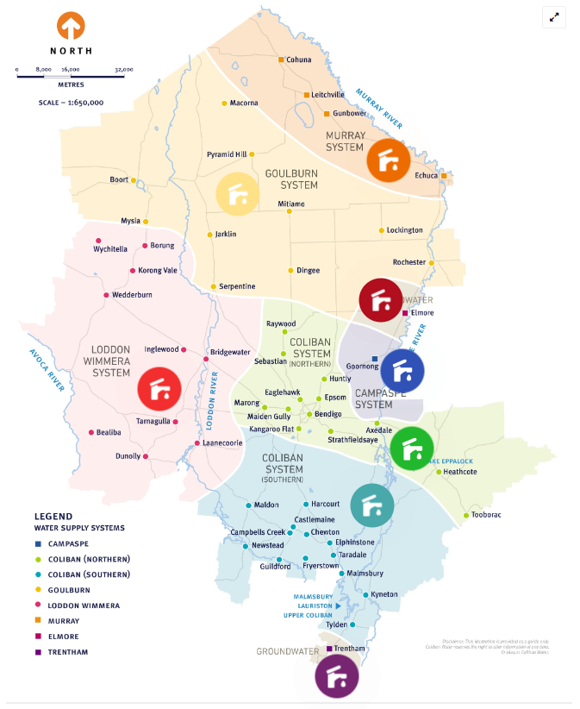
Where does your water come from?
Find out here

Slide 15
A Changing Climate

Slide 16
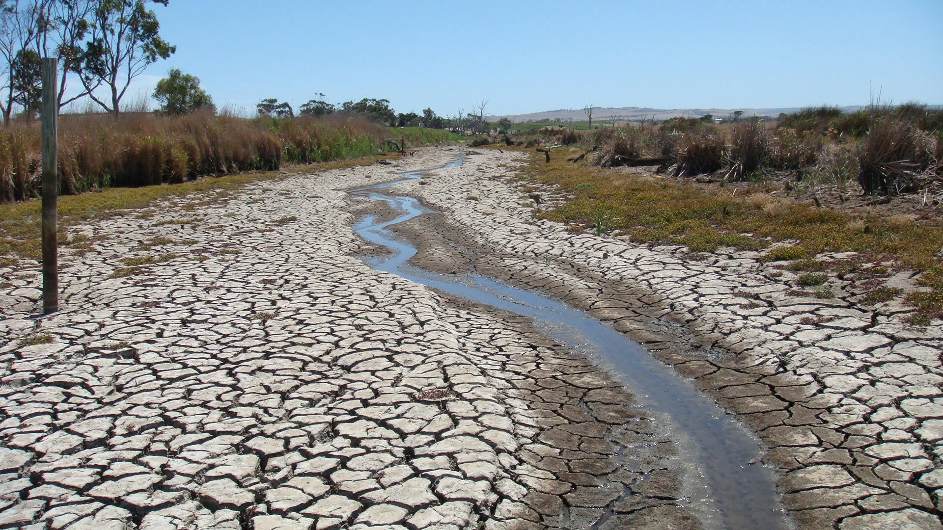
What do we know about the future?
1) Our climate is changing, which means:
less reliable rain fall;
hotter, dryer summers;
we may experience extended periods of low rainfall – this is called a drought.
We had our worst drought recently, from 2001-2009. This was called the Millennium Drought. Which devastated communities, industries and the environment.
2) Our population is increasing.
3) We will want to maintain the way we live, which means:
drinking water;
a good environment;
nice parks and gardens;
and water for farmers.
Can we have it all?

Slide 17
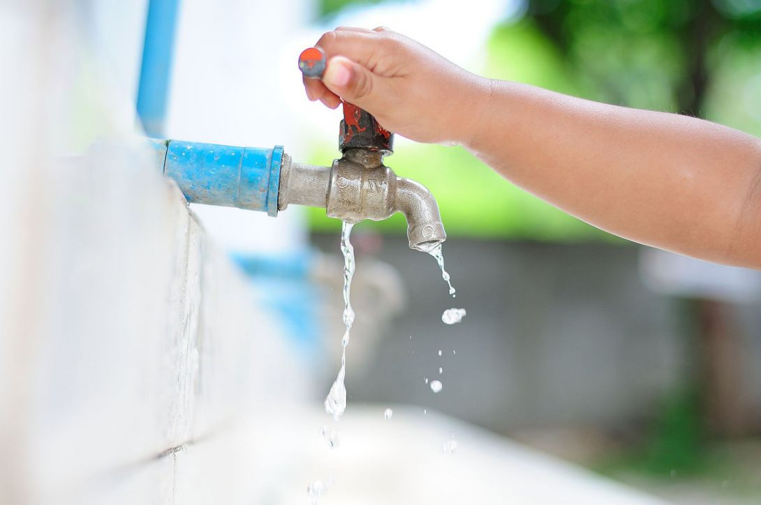
What would you choose?
Activity: Water Use Tournament
Instructions:
You are playing the role of a Community Advisory Group member.
These groups give Coliban Water advice.
You should imagine our region is entering an extended drought.
What advice will you give Coliban Water? How should water be allocated? What areas should we choose to prioritise over others?
Use the tournament bracket to decide by selecting one water use over another until you have your number one priority
Be ready to share your answers.

Slide 18
Water needs to be sustainably managed for the future of our region.
This means:
Conserving water in our homes and businesses
Reducing the need for water with smart gardens and efficient appliances
Recycling water for irrigation and parks and gardens
Protecting our water ways and catchments
We need to use water sustainably – it’s as simple as that!

Slide 19
Learning Objectives
Can you answer these questions?
Why is water so precious?
What are three things that make up the urban water cycle?
Will we always have reliable rainfall in the future?

Slide 20
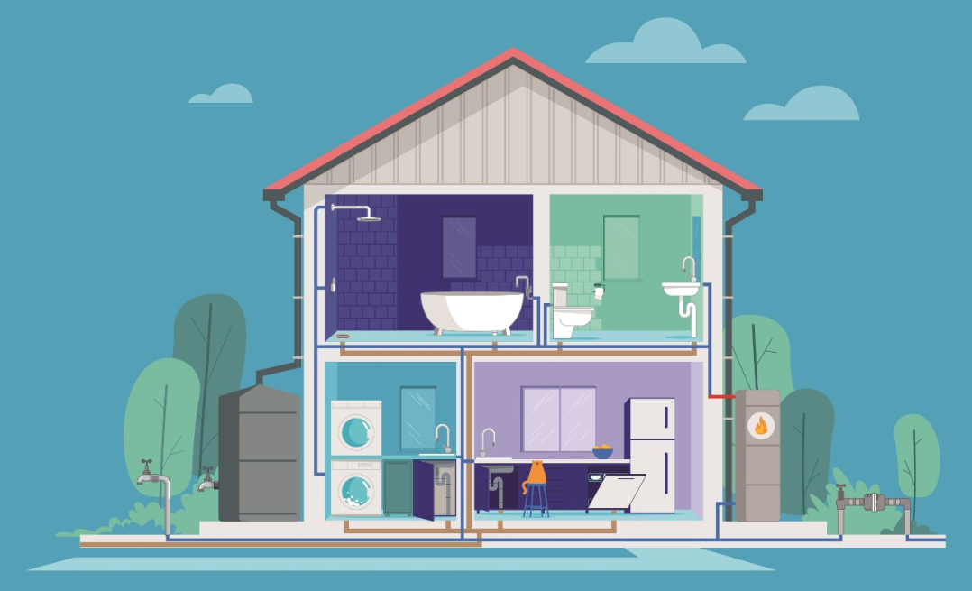
How can we save water?
Think about how you use water at home, at school, or other places.

Slide 21
Question Time

